Slide 1

Practice with Hive
WORKSHOP-1

Slide 2



Team members:
Manasa Ginjupalli Farheen Mohammad Azhar Alali

Slide 3
Table Of Contents:
What is Hive?
Characteristics
Hive Architecture
Hive Workflow
Data Types
Create database
Drop database
Create table

Slide 4
Table Of Contents:
Alter and Drop table Statement
Aggregate Functions
Select Where Clause
Select Order By Clause
Demo
References
Conclusion

Slide 5
What is Hive?
Hive was first developed by facebook.
Data warehouse framework on top of hadoop.
It is an open source.
Used for querying and analysis of data.

Slide 6
Characteristics
Reduces effort of users not familiar with well versed code.
Developed HiveQL or HQL similar to SQL.
Provides different interfaces for different users.
It’s fast, scalable and extensible.

Slide 7
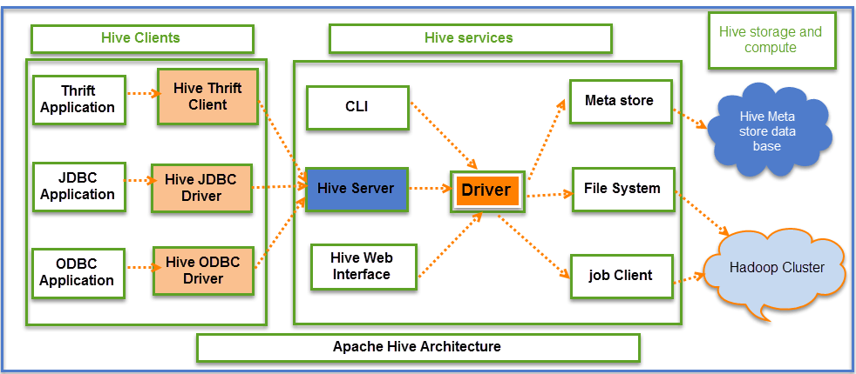
Hive Architecture

Slide 8
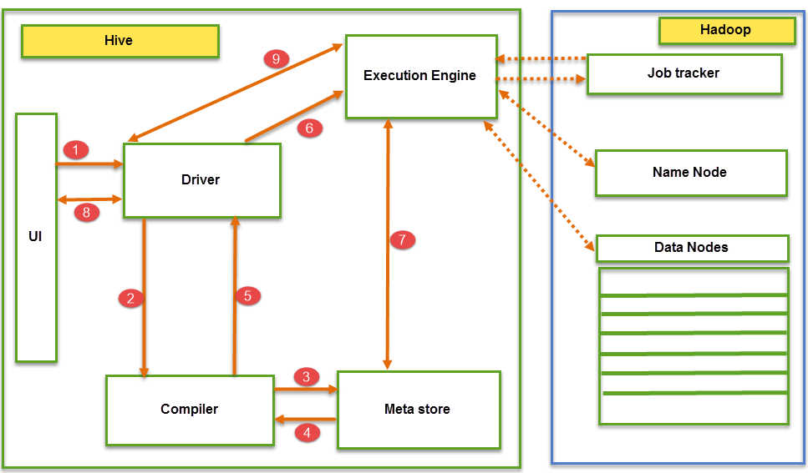
Hive Workflow

Slide 9
Hive Modes
Hive operates in two modes depending on data size of nodes in hadoop.
Local mode.
Map reduce mode.

Slide 10
Data Types
Column Types
Literals
Null Values
Complex Types

Slide 11
Creating Database
Create Database is a statement used to create a database in Hive.
The Syntax is as follows
CREATE DATABASE | SCHEMA [ IF NOT EXISTS ] <database name>
Example:
hive> CREATE SCHEMA userdb;
Verifying a databases list
hive> SHOW DATABASES default userdb;

Slide 12
Drop Database Statement
Drop Database is a statement that drops all the tables and deletes the database
Syntax:
DROP DATABASE StatementDROP ( DATABASE| SCHEMA ) [ IF EXISTS ] <database name>
Dropping the database
hive> DROP DATABASE IF EXISTS userdb;

Slide 13
CONTINUED…
Dropping the database using CASCADE
hive> DROP DATABASE IF EXISTS userdb CASCADE;
Dropping the database using SCHEMA
hive> DROP SCHEMA userdb;

Slide 14
Create table Statement
Create Table is a statement used to create a table in Hive
Example
hive>Create table if not exists employee (eid int,name String, salary String,destination String)
Comment ‘Employee details’
Row FORMAT DELIMITED
FIELDS TERMINATED BY ‘\t’
LINES TERMINATED BY ‘\n’
Stored as text file;

Slide 15
Alter and Drop table Statement
Alter is a statement used to alter the table in hive
Syntax
Alter table name rename to new_name;
Drop is a statement used to drop a table in hive
Syntax
Drop table [if exists] table_name;

Slide 16
Built In aggregate Functions
Hive supports the following built-in aggregate functions
Sum
Count
Min
Max
Avg

Slide 17
Select-Where Hive QL
The Hive Query Language (HiveQL) is a query language for Hive to process and analyze structured data
SELECT statement is used to retrieve the data from a table. WHERE clause works similar to a condition
Syntax:
Select [ALL | DISTINCT ] select_expr,select_expr,...
from table_reference
[Where where_condition]

Slide 18
Select Order By Hive QL
The ORDER BY clause in a SELECT statement.
This is almost similar to the where clause

Slide 19
Demo
AZHAR ALALI
19

Slide 20

References:
https://www.youtube.com/watch?v=rr17cbPGWGA
https://www.guru99.com/introduction-hive.html
https://www.tutorialspoint.com/hive/hive_introduction.htm
Google images

Slide 21
Learned about hive and characteristics.
Hive architecture and its components.
HiveQL queries.
How to use hive through cloudera.

